Slide 1
My Cultural Inquiry Project
By Kesler

Slide 2
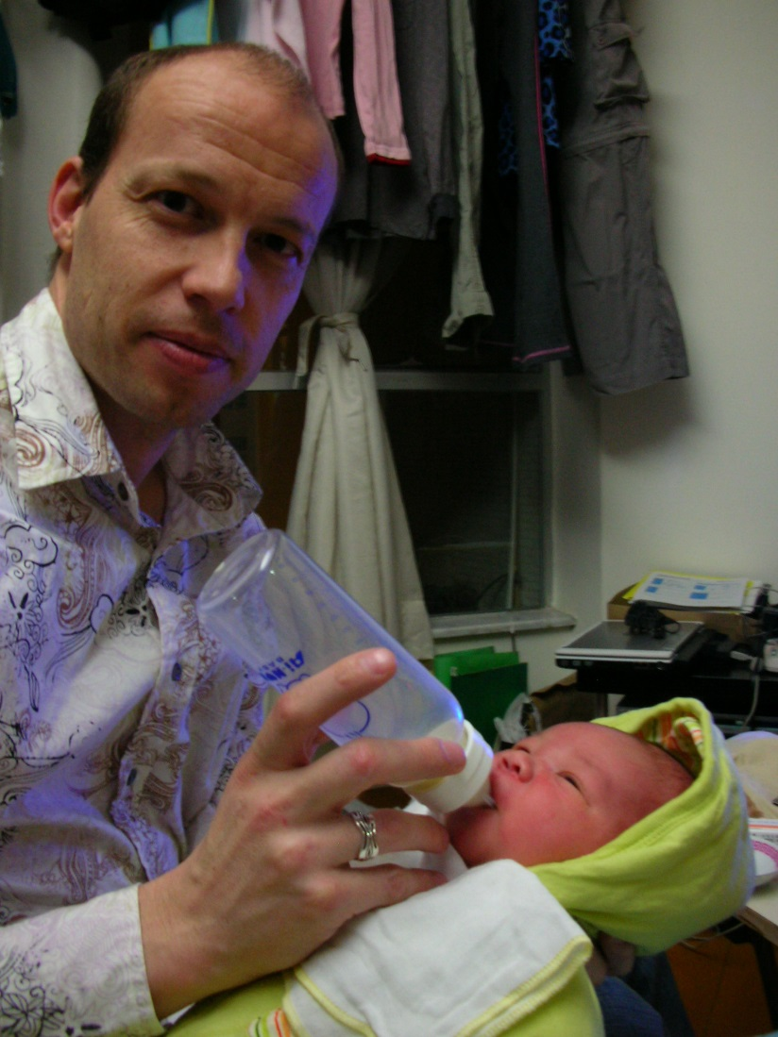
My BEGINNING
I was born in Hong Kong in Jan 8th 2008. When I was a baby I was pretty sad because I could not reach any of the tables because I was too short and I could not reach the door handles. It was fun crawling around the house. I would always do the sign for milk. I always would call my dad dada and my mom mama.

Slide 3
Our beginnings
My Mom has been to 30 different countries, such as Thailand, Japan, Australia, U.S.A, China, Philippine, Papua New Guinea, sirilanka, Italy, France etc. My Mom was born in Hong Kong and my Dad was in Victoria. My dad has two brothers: Craig and Mark, my Mom has two sisters: Fion and Chloe and one brother Kipp.

Slide 4
My Learning Journey
My first school was called Yus Montessori preschool. My favorite subject in preschool was math. My best friend in preschool was Aspen. My teacher in preschool was called Ms. Wonda. As you can see in the picture there is a globe I sowed that globe in preschool. In preschool I liked to play with the blocks.

Slide 5
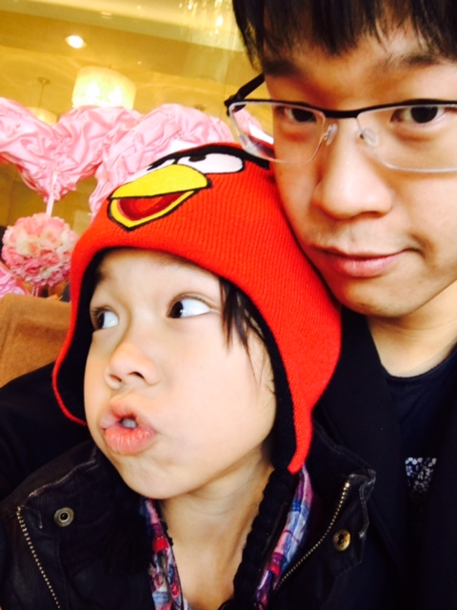
OUR languages
I can speak 3 different languages English, Cantonese and Mandarin I usually speak English at home but I speak Cantonese to my grandparents. I am still learning mandarin. When I go to Hong Kong I always speak Cantonese. I speak English to my dad because he is not Chinese.

Slide 6
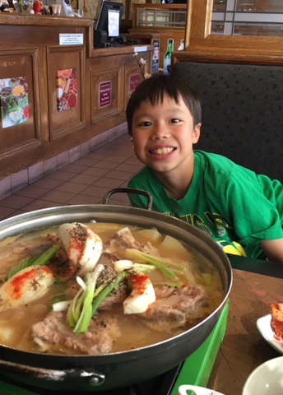
OUR FOODS
In Hong Kong we always eat rice and hot pot. My favorite food is sushi. My mom and my grandparents like to eat fish. As you can see I like hot pot a lot. My dad likes to eat eggs Benny. I don’t like to eat it. My favorite desert is a bubble waffle.

Slide 7
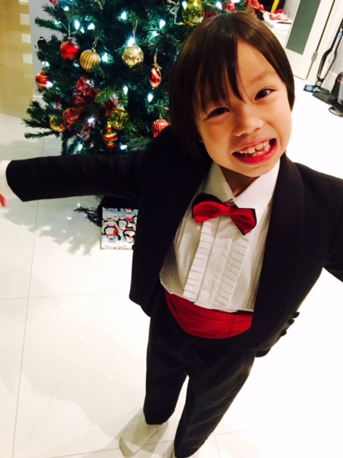
OUR CULTURAL EVENTS AND TRADITION
One of my main traditions is Chinese new year. I like Chinese new year because I can get money in red pockets. My favorite tradition that I have is Christmas because I get lots of presents.

Slide 8
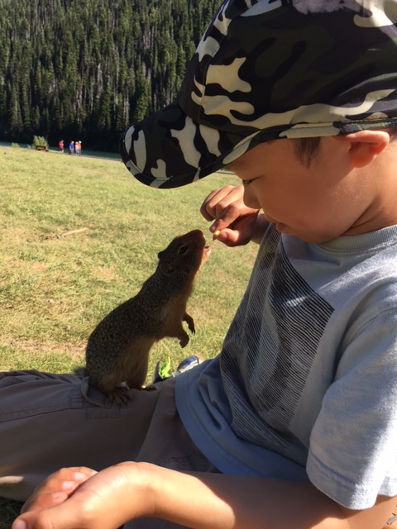
OTHER INTERESTING DETAILS
I like to go to hockey games because I get a lot of stuff like hockey pucks and hockey cards. I like swimming in the pool because I like to play in the pool and swim in it. I am a bit Scottish because my dads mom is Scottish. I like to hang out with wild animals.

